Slide 1
Chapter 7
Transformations of
Stress and Strain

Slide 2
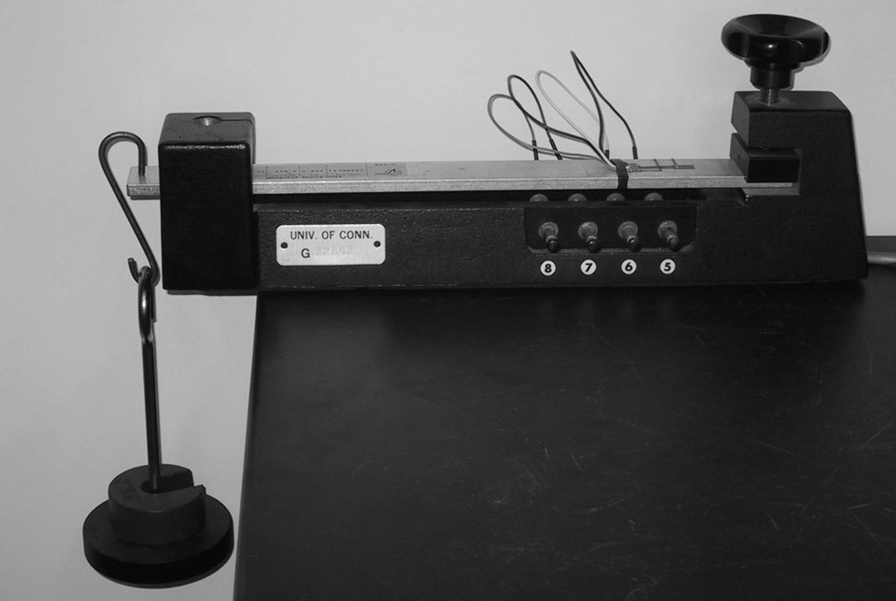
Introduction
Previously we were calculating stresses about specified areas that pass through a point. Here, we will consider the most general state of stress at a given point.
The linear strain in the top surface of the bar is being measured by a strain gage.
This part is concerned with how the components of stress are transformed under a rotation of the coordinate axes

Slide 3
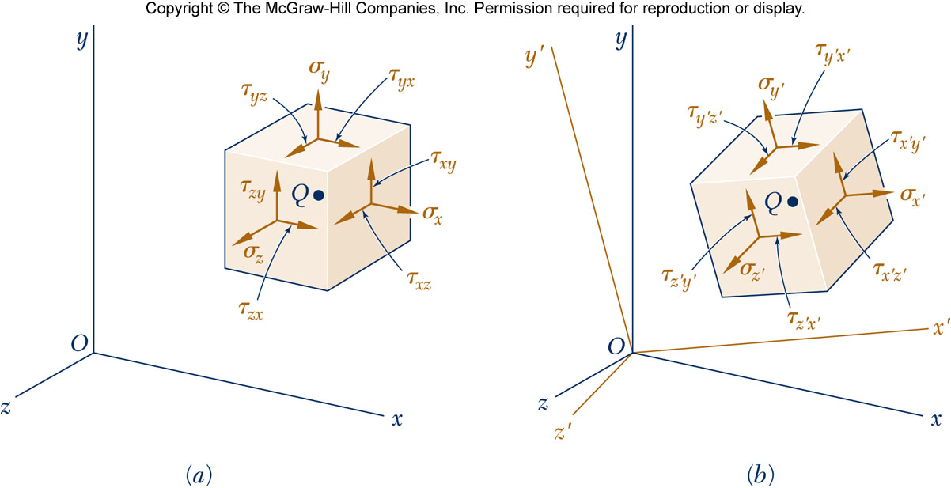
Introduction
The most general state of stress at a point may be represented by 6 components,
Normal
Shear
Same state of stress is represented by a different set of components if axes are rotated.
Normal
Shear

Slide 4
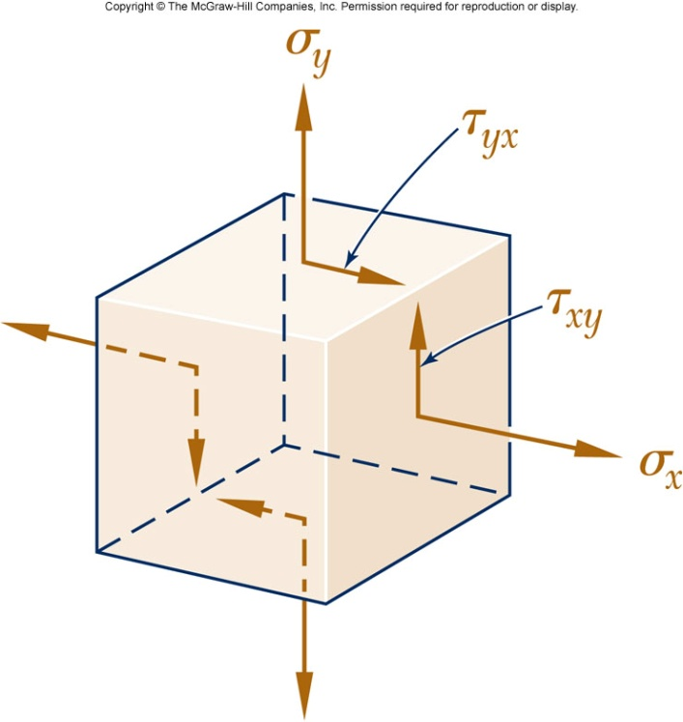
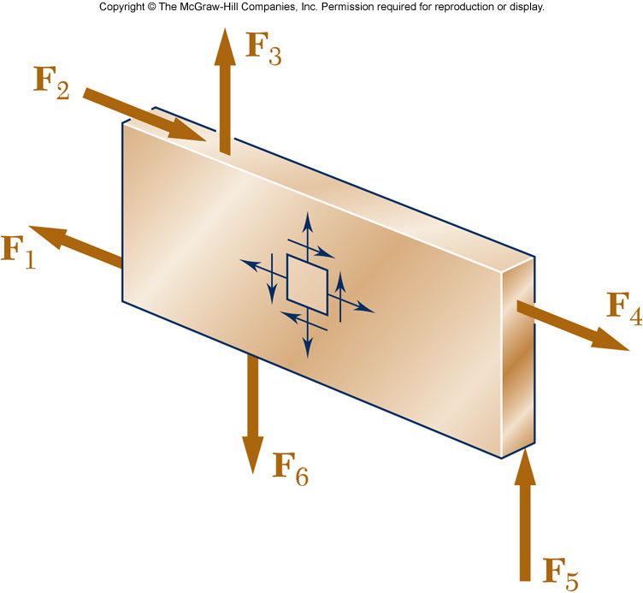
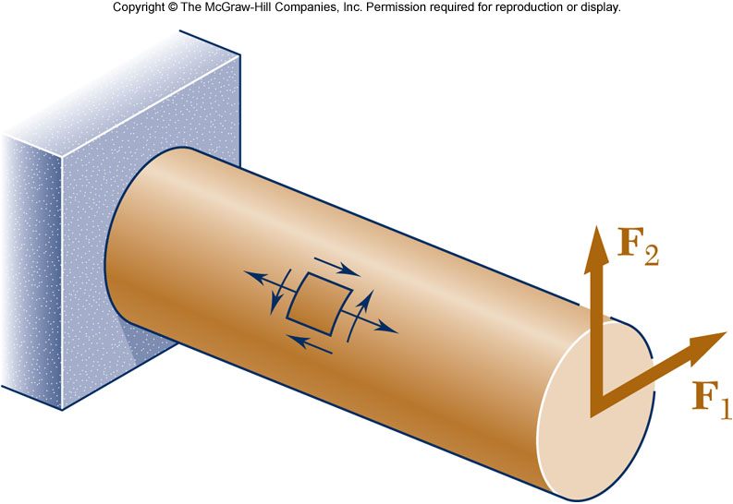
Plane Stress
Plane Stress - state of stress in which two faces of the cubic element are free of stress. For the illustrated example, the state of stress is defined by
Examples:
A thin plate subjected to forces acting in the midplane of the plate.
The free surface (not subjected to an external force) of a structural element or machine component.

Slide 5
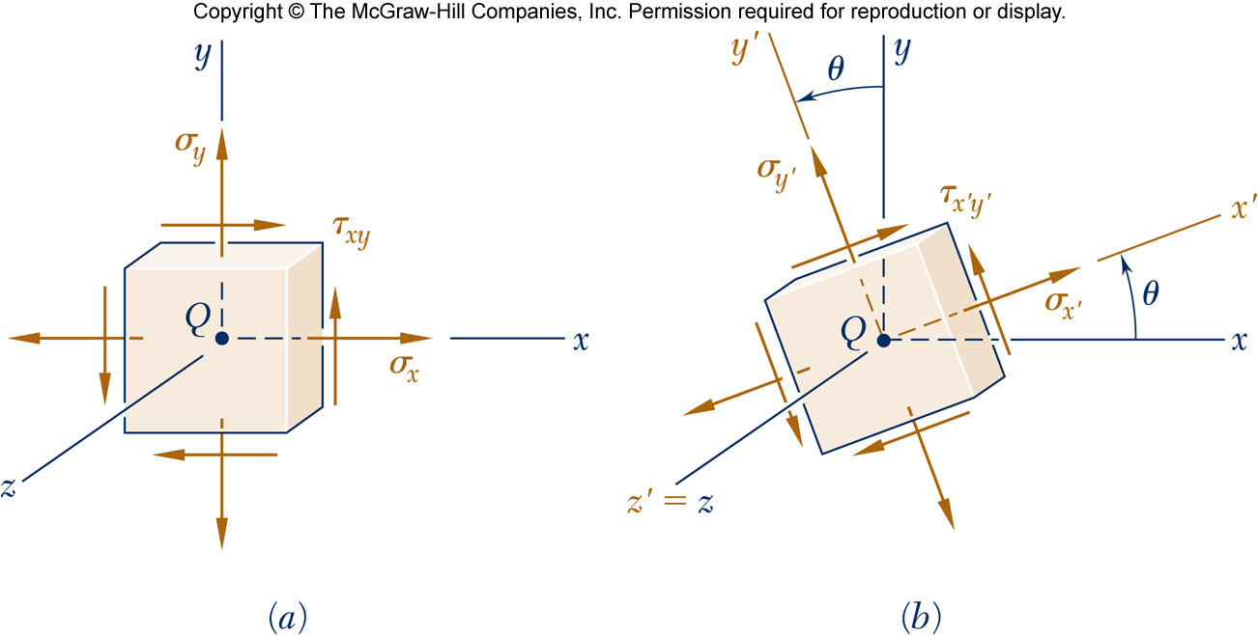
Transformation of Plane Stress
Assume that a state of stress exists at point Q (with σ_{z}=τ_{yz}=τ_{zx}=0) defined by the stress components
Determine the stress state associated with the same element after it has been rotated through an angle about the z axis (hence σ_{z’}=τ_{y’z’}=τ_{z’x’}=0)

Slide 6
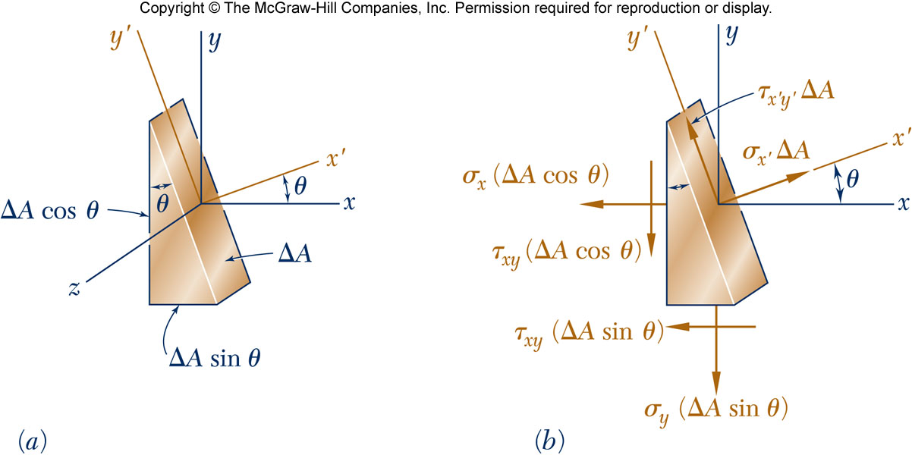
Transformation of Plane Stress
To determine the normal stress σ_{x’} and the shearing stress τ_{x’y’}, we consider the equilibrium conditions of a prismatic element with faces perpendicular to the x, y, and x’ axes.

Slide 7
Transformation of Plane Stress
Solving the equations yields
Using
The expression for the normal stress σ_{y’} is obtained by replacing θ by θ+90º

Slide 8
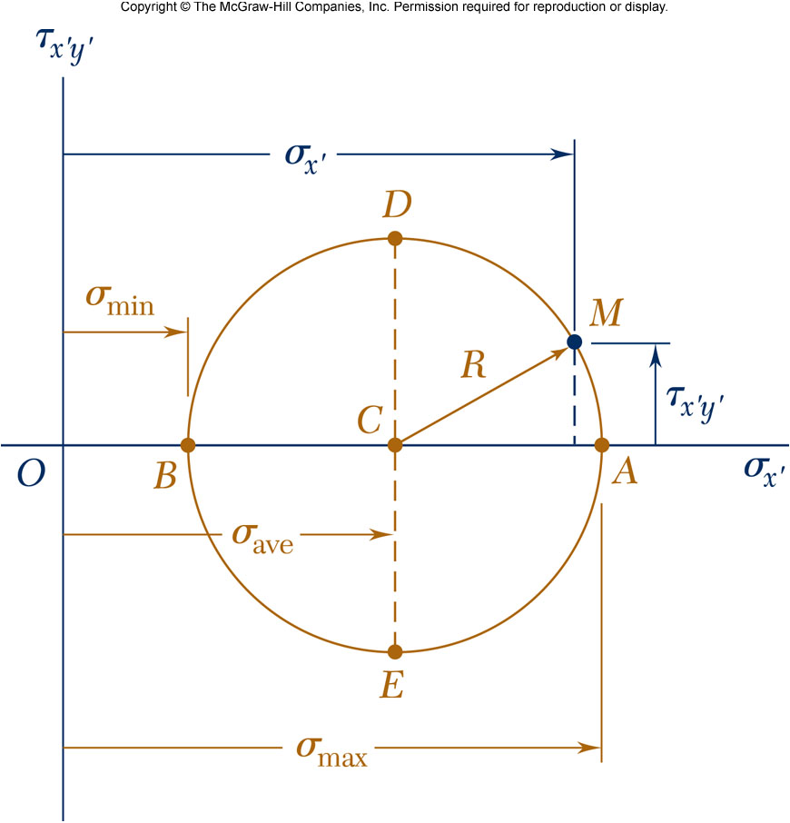
Principal Stresses
The previous equations are combined to yield parametric equations for a circle,
Circle of center (σ_{ave},0) and radius R

Slide 9
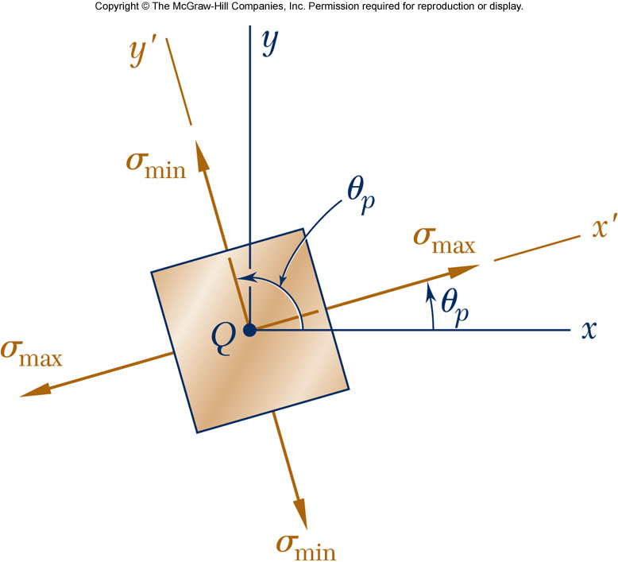
Principal Stresses
Point A: corresponds to the maximum value of σ_{x’} and zero τ_{x’y’}
Point B: corresponds to the minimum value of σ_{x’} and zero τ_{x’y’}
Principal stresses occur on the principal planes of stress with zero shearing stresses.

Slide 10
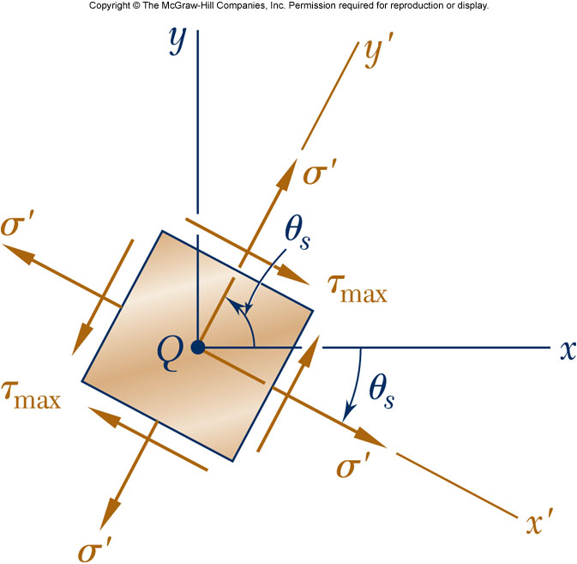
Shearing Stress
Maximum shearing stress occurs for
θ_{p} and θ_{s} are 45º apart
Maximum shearing stress

Slide 11
Example 1
7-2: For the given state of stress, determine the normal and shearing stresses exerted on the oblique face of the shaded triangular element shown. Use a method of analysis based on the equilibrium of that element, as was done in the derivations of Sec. 7.2.

Slide 12
Example 1

Slide 13
Example 2
7-6: For the given state of stress, determine (a) the principal planes, (b) the principal stresses

Slide 14
Example 3
7-12: For the given state of stress, determine (a) the orientation of the planes of maximum in-plane shearing stress, (b) the maximum in-plane shearing stress, (c) the corresponding normal stress

Slide 15
Example 4
7-22: Two members of uniform cross section 50 × 80 mm are glued together along plane a-a, that forms an angle of 25º with the horizontal. Knowing that the allowable stresses for the glued joint are σ = 800 kPa and τ = 600 kPa, determine the largest centric load P that can be applied

Slide 16
Example 4

Slide 17
Example 5
7-25: A mechanic uses a crowfoot wrench to loosen a bolt at E. Knowing that the mechanic applies a vertical 100 N force at A, determine the principal stresses and the maximum shearing stress at point H located as shown on top of the 18 mm diameter shaft.

Slide 18
Example 5

Slide 19
Example 5

Slide 20
Example 6
7-26: The steel pipe AB has a 102 mm outer diameter and a 6 mm wall thickness. Knowing that the arm CD is rigidly attached to the pipe, determine the principal stresses and the maximum shearing stress at point K.

Slide 21
Example 6

Slide 22
Example 6

Slide 23
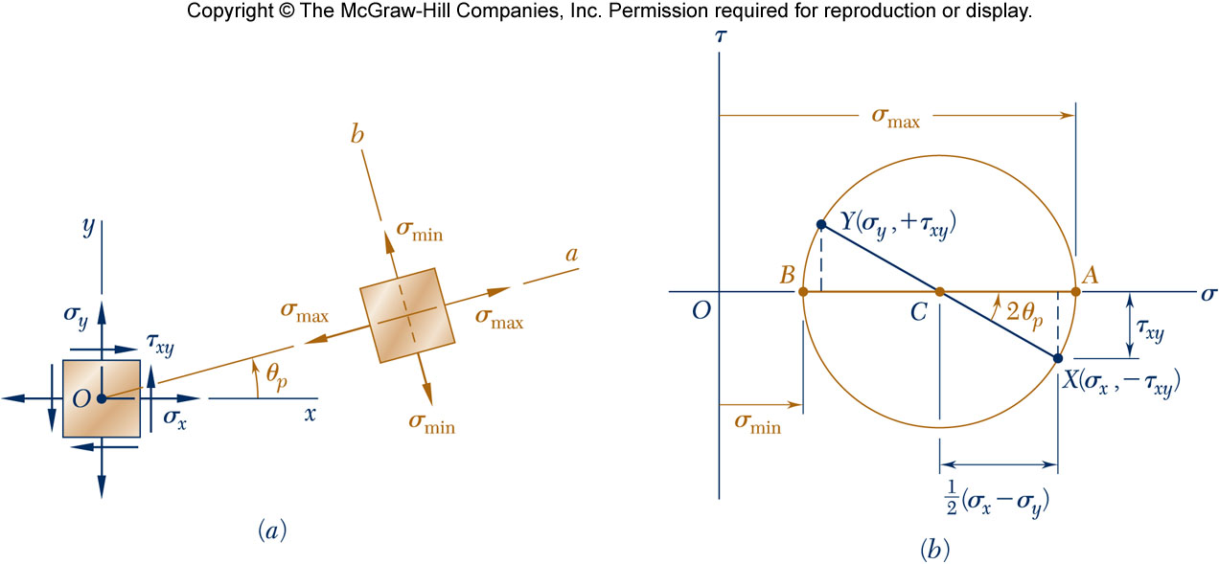
Mohr’s Circle for Plane Stress
The circle can be used to calculate the stress state of an element at any orientation.
For a known state of plane stress σ_{x}, σ_{y} and τ_{xy}, plot the points X and Y and construct the circle centered at C.
The principal stresses are obtained at A and B.
The direction of rotation of Ox to Oa is the same as CX to CA.

Slide 24
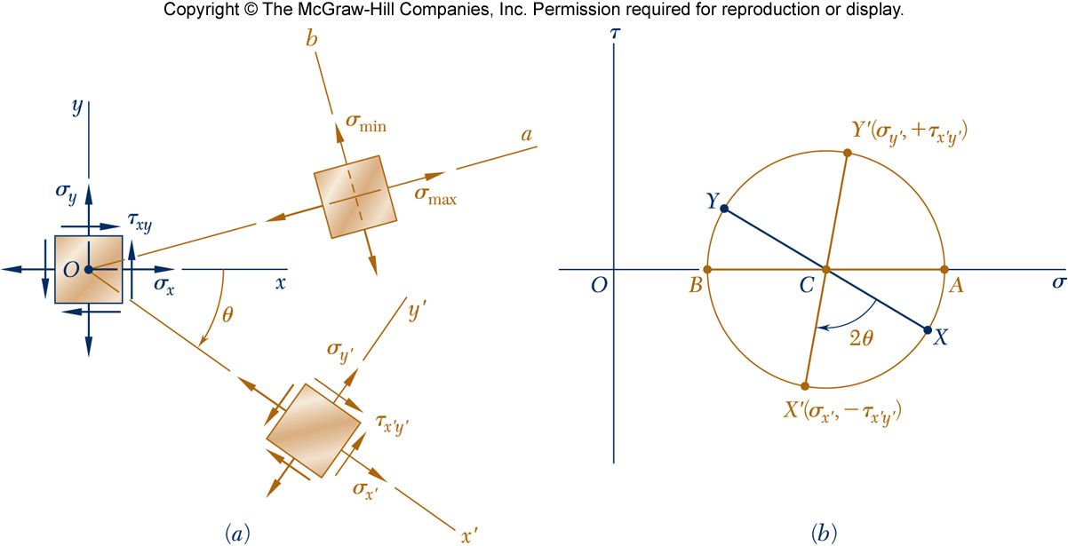
Mohr’s Circle for Plane Stress
With Mohr’s circle uniquely defined, the state of stress at other axes orientations may be depicted.
For the state of stress at an angle θ (cw) with respect to the xy axes, construct a new diameter X’Y’ at an angle 2θ (cw) with respect to XY.
Normal and shear stresses are obtained from the coordinates X’Y’.

Slide 25
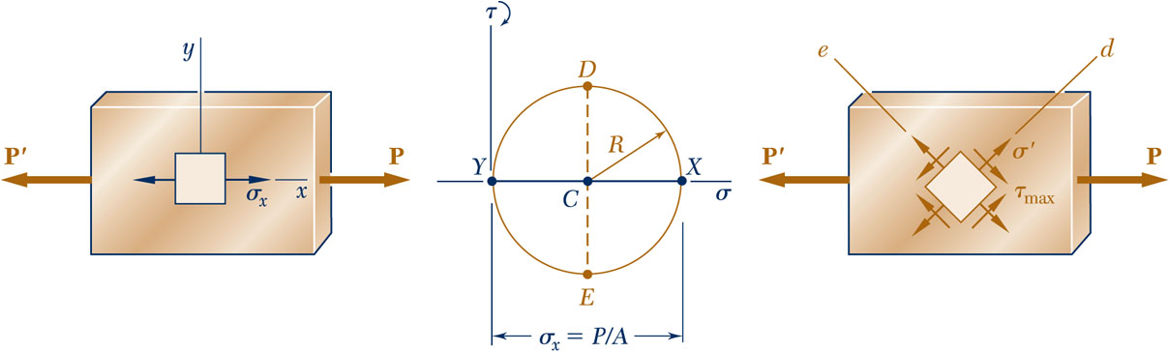
Mohr’s Circle for Plane Stress
Mohr’s circle: Centric axial loading
Points D and E yield the orientation of the planes of maximum shearing stress

Slide 26
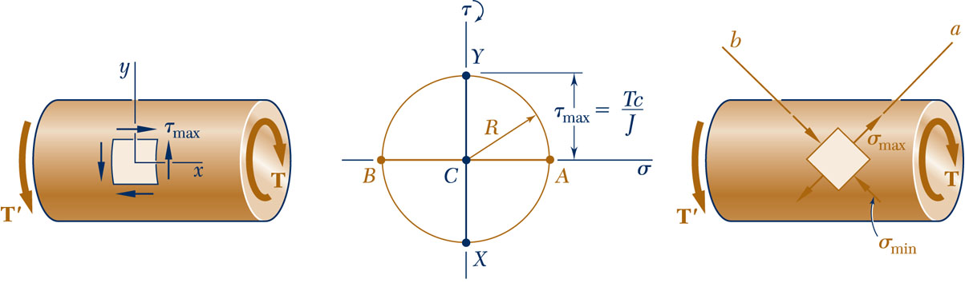
Mohr’s Circle for Plane Stress
Mohr’s circle: Torsional loading
Points A and B define the principle planes and yield the principle stresses

Slide 27
Example 7
7-36: For the given state of stress, determine using Mohr’s circle the normal and shearing stresses after the element shown has been rotated through (a) 25º clockwise, (b) 10º counterclockwise.

Slide 28
Example 7

Slide 29
Example 8
7-44: Two members of uniform cross section 50 × 80 mm are glued together along plane a-a, that forms an angle of 25º with the horizontal. Knowing that the allowable stresses for the glued joint are σ = 800 kPa and τ = 600 kPa, determine the largest centric load P that can be applied using Mohr’s circle.

Slide 30
Example 8

Slide 31
Example 9
7-55: Determine the principal planes and the principal stresses for the state of plane stress resulting from the superposition of the two states of stress shown.

Slide 32
Example 9

Slide 33
General State of Stress
Consider the general 3D state of stress at a point and the transformation of stress associated with element rotation. Our analysis will be limited to the determination of σ_{n} on a plane of arbitrary orientation.
State of stress at Q defined by:

Slide 34
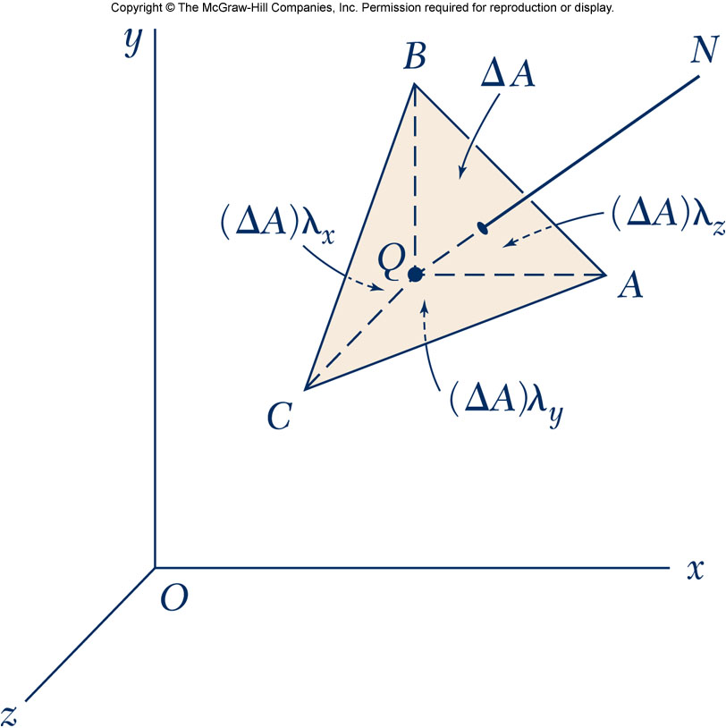
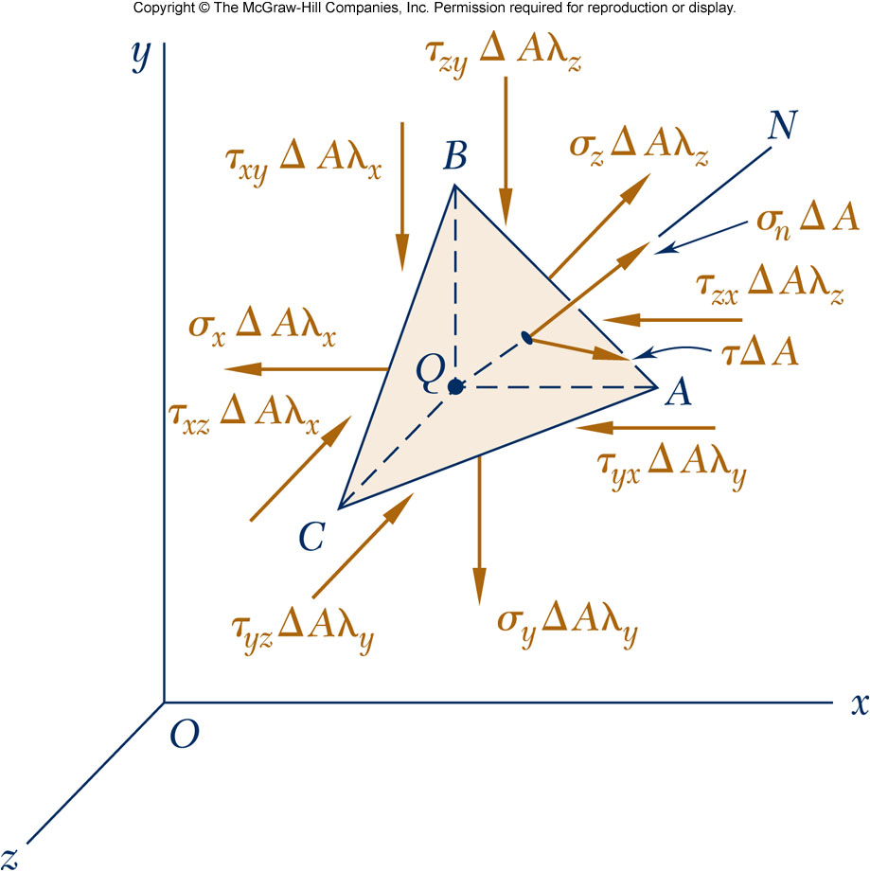
General State of Stress
Consider the tetrahedron with a face perpendicular to the line QN with direction cosines
The forces exerted on ABC consist of a normal force σ_{n} ΔA directed along QN and of a shearing force of magnitude τ ΔA perpendicular to QN

Slide 35
General State of Stress
The statics requirements lead to
Dividing by ΔA
and
solving for σ_{n}

Slide 36
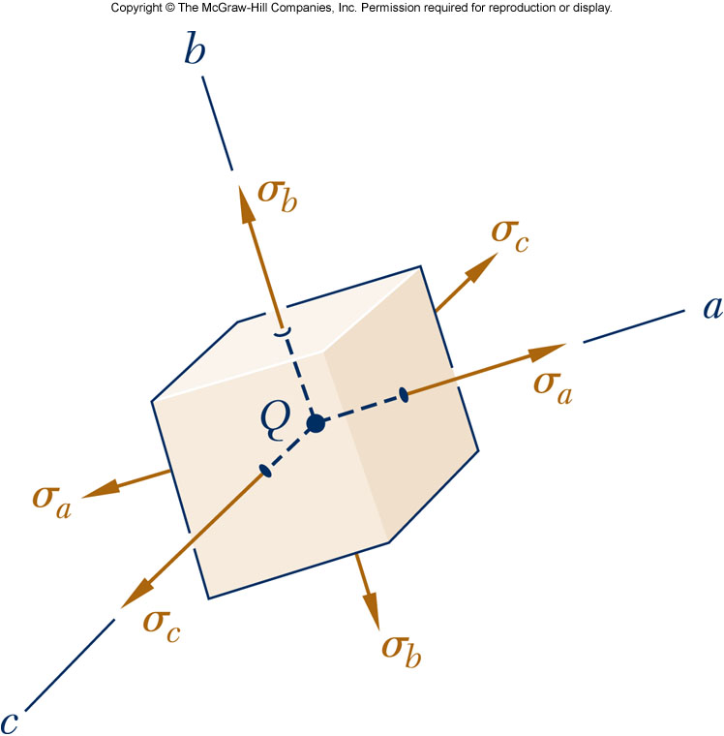
General State of Stress
Now select the axes in such a way that the right-hand member reduces to the three terms containing the squares of the direction cosines
The coordinate axes a, b, c are referred to as the principal axes of stress. The corresponding coordinate planes are known as the principal planes of stress and the corresponding normal stresses σ_{a}, σ_{b}, and σ_{c} as the principal stresses at Q.

Slide 37
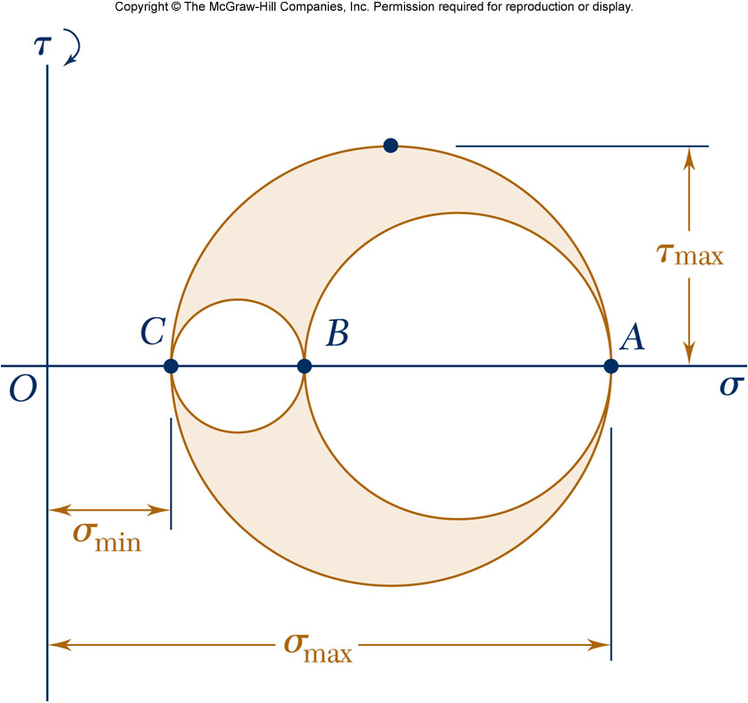
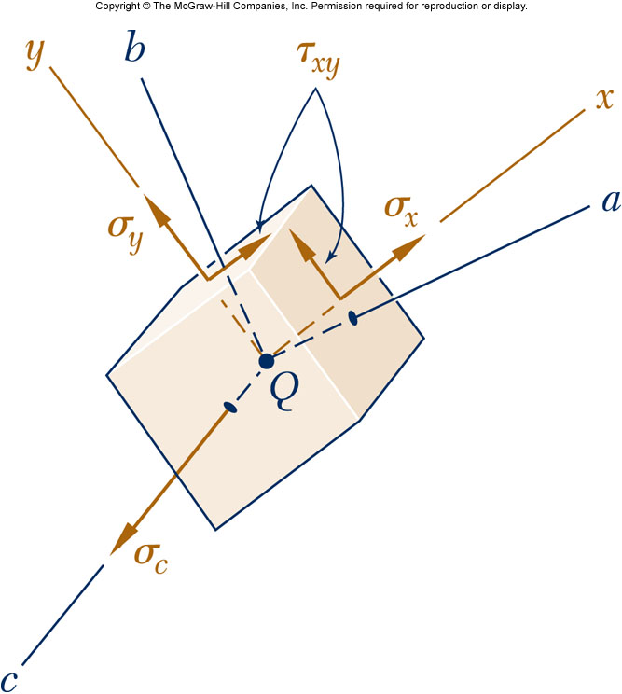
Mohr’s Circle 3D Analysis of Stress
Circle AB rotation about the principle axis Qc
Circle BC rotation about the principle axis Qa
Circle AC rotation about the principle axis Qb
The transformation about any different axis will lead to a stress state defined by a point in the shaded area.

Slide 38
Mohr’s Circle 3D Analysis of Stress
The three circles represent the normal and shearing stresses for rotation around each principal axis.
Radius of the largest circle yields the maximum shearing stress.

Slide 39
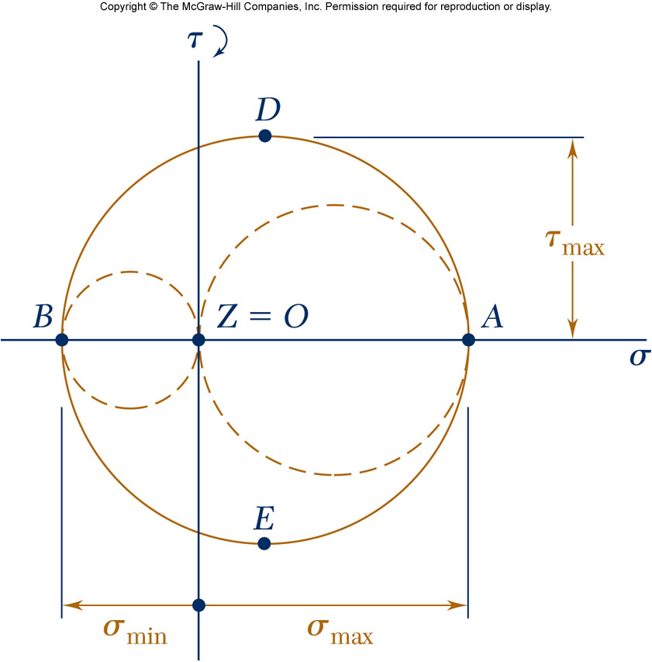
Mohr’s Circle 3D Analysis of Stress
Plane stress case: the z axis is a principal
Points A and B (representing the principal planes) are on opposite sides of the origin O.
Case I:
  The corresponding principal stresses are the maximum and minimum normal stresses for the element
  The maximum shearing stress for the element is equal to the maximum “in-plane” shearing stress
  The planes of maximum shearing stress are at 45º to the principal planes.

Slide 40
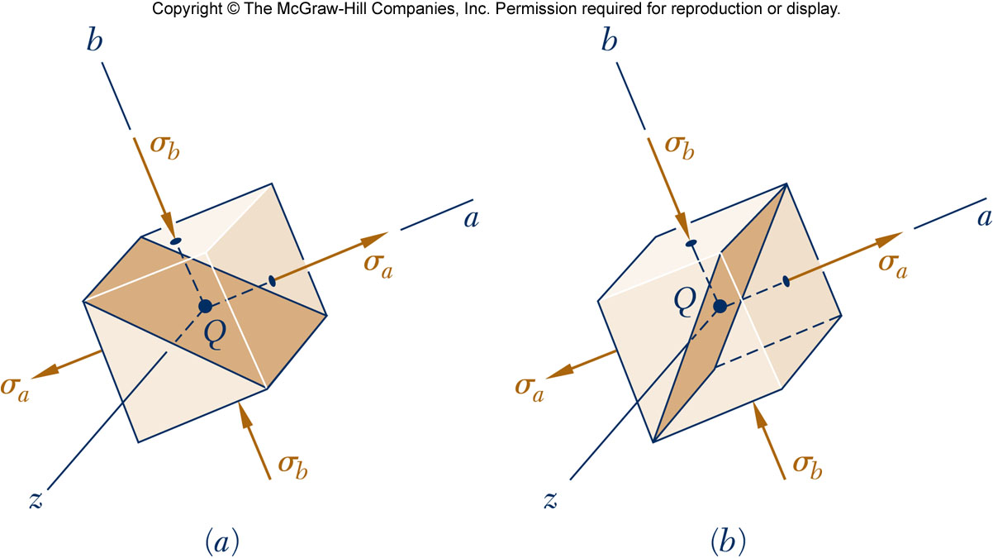
Mohr’s Circle 3D
Plane stress case: the z axis is a principal
  The planes of maximum shearing stress correspond to points D and E, and are at 45º to the principal planes.

Slide 41
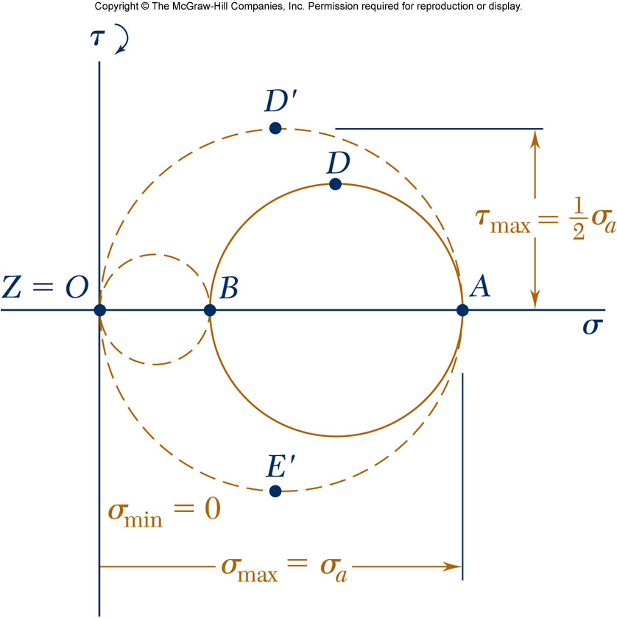
Mohr’s Circle 3D Analysis of Stress
Plane stress case: the z axis is a principal
Points A and B (representing the principal planes) are on the same sides of the origin O.
Case II:
  The circle defining σ_{max}, σ_{min}, and
  τ_{max} for the element is not the circle corresponding to transformations within the plane of stress
  The maximum shearing stress for the element is equal to half of the maximum stress
  The planes of maximum shearing stress are at 45º to the plane of maximum normal stress

Slide 42
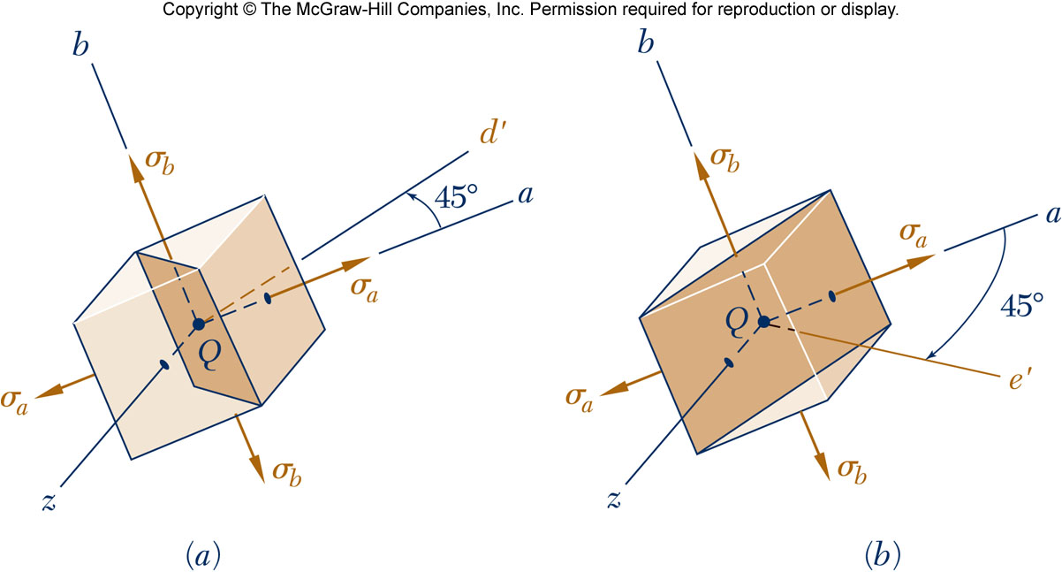
Mohr’s Circle 3D
Plane stress case: the z axis is a principal
  The normals Qd’ and Qe’ to the planes of maximum shearing stress are obtained by a 45º rotation about the Qb axis of the Qa or the Qc axis.

Slide 43
Example 10
7-68: For the state of stress shown, determine the maximum shearing stress when (a) σ_{y} = 40 MPa, (b) σ_{y} = 120 MPa. (Hint consider both in-plane and out-of-plane shearing stresses.)

Slide 44
Example 10

Slide 45
Example 11
7-71: For the state of stress shown, determine the maximum shearing stress when (a) σ_{z} = 0 MPa, (b) σ_{z} = 60 MPa, (c) σ_{z} = -60 MPa.

Slide 46
Example 11

Slide 47
Example 12
7-75: For the state of stress shown, determine the value of τ_{xy} for which the maximum shearing stress is (a) 63 MPa, (b) 84 MPa.

Slide 48
Example 12

Slide 49
Example 13
7-79: For the state of stress shown, determine two values of σ_{y} for which the maximum shearing stress is 80 MPa.

Slide 50
Example 13

